Slide 1


April 2nd, 2024
1:00pm – 4:00pm
Oregon Conservation and Recreation Fund
Advisory Committee Meeting
Virtual Meeting

Slide 2
Agenda Item 1:
Review and Approve Meeting Minutes
(March 5th, 2024)

Slide 3
Draft Motion Templates re: Minutes
I move to approve the March 5th, 2024 meeting minutes with the continued authority to correct spelling, grammar, and punctuation.
I move to approve the March 5th, 2024 meeting minutes with the addition/correction/ deletion of ____ on page ___, line ____, and continued authority to correct spelling, grammar, and punctuation.

Slide 4
Agenda Item 2:
Palensky-Hwy 30 Wildlife Underpass Project: Intro and Process Summary

Slide 5
OCRF Urgent Grant Introduction
Palensky – Highway 30 Wildlife Underpass Project (frog crossing)
High priority project: When $5M in wildlife connectivity funds were identified for OCRF in the 2023 legislative session (HB 5030 Section 2, and tied to HB 2999), this Palensky frog crossing project was identified in legislative hearings as the example of what the funding could go toward.
Requesting pre-approval of funds from the OCRF: $495K (from Lottery Fund Bond for Wildlife Connectivity scheduled for March 2025)
Has the support of ODFW's Habitat Division, Wildlife Division, West Region, and North Willamette Watershed District leadership.

Slide 6
OCRF Urgent Grant Process
Applicant fills out an Urgent Grant pre-application form.
Applicant has a pre-application meeting with ODFW (OCRF Coordinator).
ODFW brings request to OCRF Chairs. If they believe it’s a viable request, Chairs form an Urgent Grant subcommittee (consisting of </= 4 members, 1 is Chair).
Subcommittee reviews the pre-application form and receives a presentation from the applicant.
If approved for next steps by the subcommittee, the applicant will submit a full application.
ODFW staff technical review: 2 technical reviewers will score the project.
Advisory subcommittee reviews: all of subcommittee will score and review the project.
Whole Advisory Committee receives application and pre-application.
Applicant optional presentation at OCRF Advisory Committee public meeting (which can be rescheduled to expedite process).
Approval: ODFW takes the recommended Urgent Grant project to Fish and Wildlife Commission for final approval.
Committee considers and recommends project.
Notes:
Enhanced application questions
Grant receipt history: Have you previously received grants aside from OCRF? What was the $ amount of the largest grant you have received? Who was the granting agency?
How does your project align with the Oregon Conservation Strategy?

Slide 7
OCRF Palensky Wildlife Underpass: Urgent Grant Process Summary
Palensky – Highway 30 Wildlife Underpass Project (frog crossing)
The applicants met with ODFW to discuss the proposed project and the pre-application was submitted.
The OCRF chairs assigned a subcommittee consisting of Karl Wenner (Chair), Mauricio Valadrian (Vice-Chair), Jane Hartline and Mark Stern.
The subcommittee met on February 29, 2024 to hear a project presentation and consider funding the Palensky – Highway 30 Wildlife Underpass Project from the Willamette Wildlife Mitigation Program (WWMP).
Subcommittee recommended project move to the full committee. March 4th: OCRF AC received a staff recommendation and the pre-application.
March 26th: OCRF Advisory Committee received full application, technical staff reviews, and subcommittee reviews
April 2: Palensky team presentation to OCRF AC and consideration of project pre-approval.

Slide 8
Agenda Item 2a:
Urgent Project Presentation: Palensky-Hwy 30 Wildlife Underpass Project
Rachel Wheat, Wildlife Connectivity Coordinator

Slide 9
Draft Motion Template re: Urgent Project Request
I move that the Committee recommends a pre-approved expenditure of $495,000 on the urgent project request “Palensky-Hwy 30 Wildlife Underpass” for consideration by the Commission.

Slide 10
Agenda Item 3:
OCRF Program Updates

Slide 11
OCRF Program Updates
OCRF Strategic Plan – official adoption will be at the May 7th OCRFAC meeting.
OCRF Communications Strategy
  OCRF Chairs, ODFW staff, and OWF met on March 4th to discuss plans to develop a Communications Scope of Work
June 4th project selection: will be in-person meeting. OCRF project site tour on June 5th TBD
Spring RFP deadline extended: Closing today at Midnight!
Notes:
Conducted outreach, and OCRF representation at the Oregon outdoor recreation programs, trail alliances, Diversifying the pool of applicants that apply to OCRF. Hopefully this helps address the

Slide 12
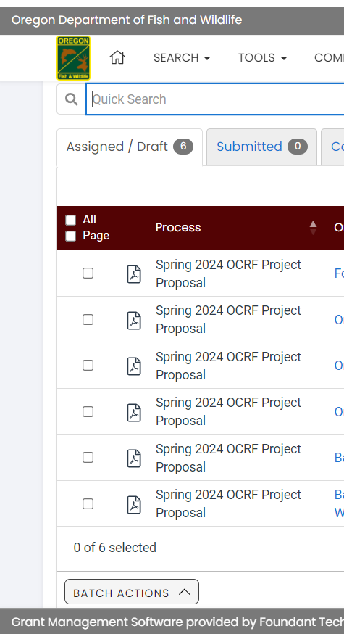
OCRF RFP Update - Spring 2024
Request for Proposals (RFP) – Open January 30th, 2024
Official RFP Guidance made public
Request for Proposals (RFP) – Closes March 26th, April 2nd 2024 (TODAY!)
Application must be received by 11:59pm
CURRENT TALLY…………….DRAFTS: 46 SUBMITTED: 44
Technical Review Period – April 3rd to April 29th, 2024
OCRF Advisory Committee Review Period – April 29th to May 23rd, 2024
OCRF Advisory Committee Recommendations – June 4th, 2024
ODFW Commission Voting – June 14, 2024
Release of funds following contracting process – August/September 2024

Slide 13
Agenda Item 4 :
Break
(Please be back in 10 min)

Slide 14
Agenda Item 5:
Review OCRF Insurance Contingency

Slide 15
Agenda Item 5:
Review and Consider OCRF Insurance Contingency

Slide 16
“New” – Insurance Guidelines
General Activity Insurance Requirements General activity insurance requirements apply to all grantees. Grantees must ensure all contractors and consultants hired under these projects will also carry the minimum insurance types and amounts.
Specialized Activity Insurance Requirements Some projects carry a greater risk to the organization, organization’s employees, volunteers, and the community. For projects in which the grantee is performing specialized activities, grantees will be required to meet the minimum General Insurance requirements plus any required specialized insurance shown below.
Boat: Transporting people on lakes, rivers, streams, or ocean in motorized boats.
Supervising minors, other clients: Having any kind of custodial care of minors or others in custodial care of the state. Example: Activities for unaccompanied minors.
Transporting 15+ people: Transport of 15+ passengers in a bus/van per vehicle.
Pesticides or herbicides: Applying pesticides or herbicides.
https://www.dfw.state.or.us/conservationstrategy/OCRF/docs/OCRF%20Insurance%20Requirements%202023_Grantee%20Guidelines%20v1.0.pdf

Slide 17
Draft Motion Templates re: Insurance Contingency
I move that the Committee recommends expenditure of up to $20,000 to support insurance requirements for selected projects for consideration by the Commission.
The Department is instructed to use these funds to support selected projects who request additional financial assistance in order to reach required insurance levels required for contracting. The Department will use their discretion to determine which projects receive additional support based on requesting applicant’s description of their needs.

Slide 18
Agenda Item 6:
Public Comment

Slide 19
Agenda Item 7:
Meeting Wrap-up

